Slide 1
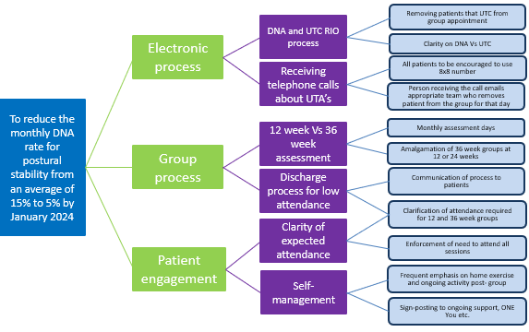
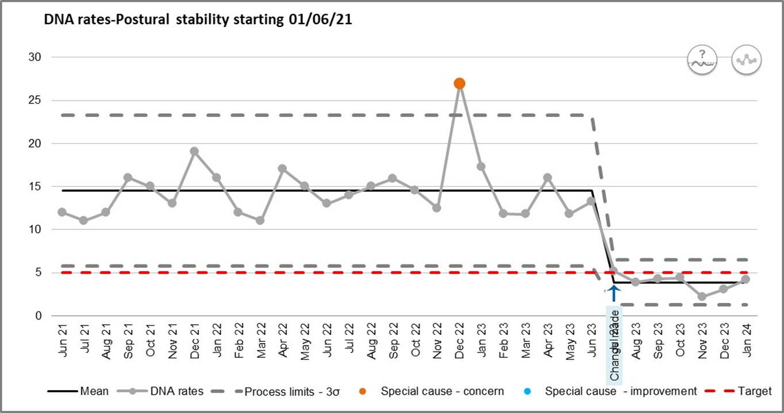
Improvement : Reducing the do not attend (DNA) rates for postural stability exercise sessions Project team: Peter Ellis and the postural stability team
Problem statement:
It is evidenced that people at risk of falling require a tailored postural stability exercise programme of over 50 hours to reduce their risk. In June 2023, an average of 15 per cent of all class appointments were recorded as DNAs. This was not thought to be an accurate reflection of the number of patients not attending a group without prior notification to the team. Those that do not attend a session or drop-out of the group do not get the full benefit of the programme and may also prevent someone else being offered a place in that cohort.
SMART aim:
To reduce the monthly DNA rate for postural stability class appointments from an average of 15 per cent to 5 per cent by January 2024.
Measures to track improvement:
Measuring the DNA rates for the postural stability groups supports the Trust’s We Care ambition of putting communities first and the target of service DNA rates of less than 5 per cent.
Monitoring satisfaction (Meridian surveys) with the service will reflect how the patient group has been impacted by the changes and links to the trust ambition of better patient experience.
Tests of change:
Process mapping in June 2023 identified there is variation in the group start-up process and difficulties with patients that are either unable (UTA) or do not attend (DNA) sessions.
Plan, do study, act (PDSA) cycle one and two plan (July 2023)
1.For the whole team to know how to remove a patient from a session on RIO if UTA rather than outcoming as DNA. Predict a reduction in DNA rate for the team. Provide support for process change, aim for full implementation within a month. Continue to review monthly RIO DNA report for the team.
2.To get all patients to use the team’s 8X8 number to make contact. Predict a reduction in patients who are UTA being outcomed on RIO as DNAs. All new and current patients to be re-issued with the 8X8 number and encouraged to use to cancel sessions rather than calling the clinician’s work mobile, which may not be answered or followed up in a timely manner. Team to be involved at team meeting and asked to implement asap and reviewed through weekly meeting. Continue to review monthly RIO DNA report for the team.
Data:
Monthly DNA rates have reduced from an average of 15 per cent to an average of 3.8 per cent between July 2023 and January 2024.
Meridian survey patient satisfaction rates have remained unchanged throughout at 100% good or very good.
Results, what we learned and what’s next:
Since implementation of the process changes in July 2023, there has been a significant reduction in the number of DNAs being recorded for the postural stability groups. The SMART aim has been exceeded with a reduction in average DNA rate from 15 per cent to 3.89 per cent per month, this is also within the trust’s goal of 5 per cent.
The team also report that the new process saves time not having to follow-up with non-attendees the day after the group. Patients now have a clearer process to inform the team when they are unable attend a group session and there has been no impact on patient satisfaction with the service following the changes.
What’s next?
The team is now looking at how to improve retention of patients on their longer group programmes to improve clinical outcome and reduce risk of falls.
Notes:
Comments:
Equity
How do you know you have the right services and sizes for patients
‘Community’ – need to be more specific – system working
With me not to me
Codesign and inclusion
Collaboration and focus on health needs
Fully integrated working across the system
Drafting notes from the group:
Problem – access / outcomes / experience – equity for all
Fragmented pathways contributing factors: complex systems, barriers – communication etc., Late referrals, Waiting times
We cannot be certain that all the people we serve have equity of access / outcomes / experience to / of our services
Know what services we deliver or wait too long / do not know / not helped to access our services
Vision drafting notes from the group:
Work with patients to provide seamless care across the pathways to receive the care they need
We will empower people to access the right service at the right time
We will be creative to enable easy access into our services. Working as part of the community so people feel supported to get the right care at the right time
We will work in partnership with our local communities and voluntary services to co-design our services to meet their needs
People will have equitable outcomes and experience

Slide 2
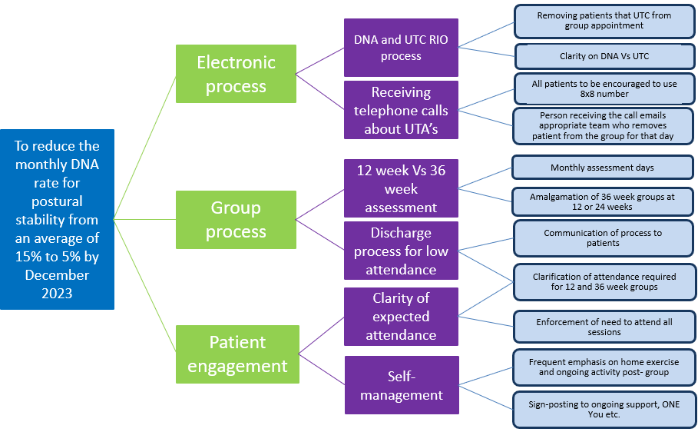
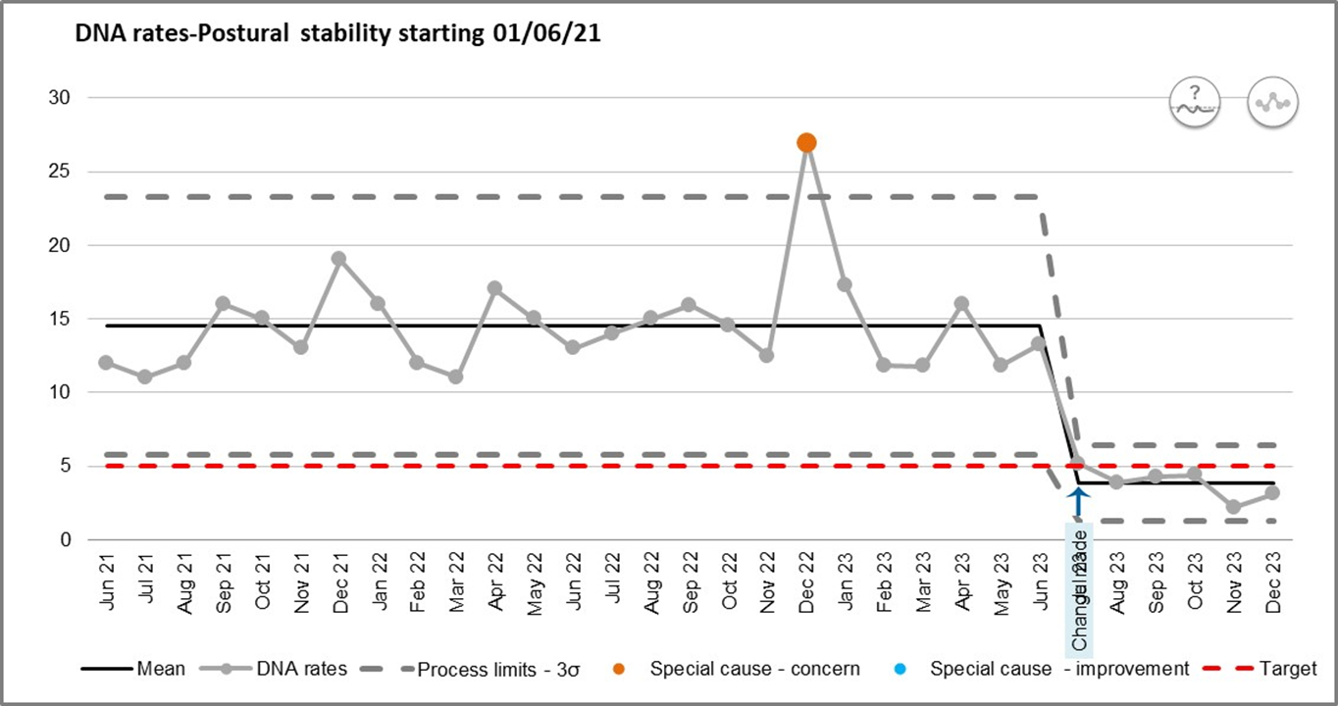
Improvement : Reducing the DNA rate for postural stability exercise sessions Project team: Peter Ellis and the postural stability team
Problem statement:
It is evidenced that people at risk of falling require a tailored postural stability exercise programme of over 50 hours to reduce their risk. In June ‘23 there was an average of 15% of all class appointments that were not attended by the patient (DNA). Those that do not attend a session or drop-out of the group do not get the full benefit of the programme and may also prevent someone else being offered a place in that cohort.
SMART aim:
To reduce the monthly DNA rate for postural stability class appointments from an average of 15% to 5% by December 2023.
Measures to track improvement:
Links to Trust We Care ambition of ‘Putting Communities First’. The target for Did Not Attend (DNA) rates within KCHFT adult services is under 5%.
Tests of change:
Process mapping in June ’23 identified that there is variation in the group start-up process and difficulties with patients that are either unable or do not attend all the sessions.
PDSA cycle one and two plan (July ‘23)
1.For the whole team to know how to remove a patient from a session on RIO if UTA rather than outcoming as DNA. Predict that there will be a reduction in DNA rate for the team. To provide support for process change, aim for full implementation within a month. Continue to review monthly RIO DNA report for the team.
2.To get all patients to use the teams 8X8 number to make contact. Predict that there will be a reduction in patients that are Unable to Attend (UTA) being outcomed on RIO as Did Not Attend (DNA). All new and current patients to be re-issued with the 8X8 number and encouraged to use to cancel sessions rather than calling the clinicians work mobile, which may not be answered or followed up in a timely manner. Team to be involved at team meeting on 5th July 2023 and asked to implement asap and reviewed through weekly meeting. Continue to review monthly RIO DNA report for the team.
Data:
Monthly DNA rates have reduced from an average of 14.52% to an average of 3.84% between July and December 2023.
Results, what we learned and what’s next:
Work on problem statement- why is it a problem?
Feedback from team on process change
New process taking more time? (question from Anna K at adult QI board)
Think about patient engagement- reasons for DNA
Notes:
Comments:
Equity
How do you know you have the right services and sizes for patients
‘Community’ – need to be more specific – system working
With me not to me
Codesign and inclusion
Collaboration and focus on health needs
Fully integrated working across the system
Drafting notes from the group:
Problem – access / outcomes / experience – equity for all
Fragmented pathways contributing factors: complex systems, barriers – communication etc., Late referrals, Waiting times
We cannot be certain that all the people we serve have equity of access / outcomes / experience to / of our services
Know what services we deliver or wait too long / do not know / not helped to access our services
Vision drafting notes from the group:
Work with patients to provide seamless care across the pathways to receive the care they need
We will empower people to access the right service at the right time
We will be creative to enable easy access into our services. Working as part of the community so people feel supported to get the right care at the right time
We will work in partnership with our local communities and voluntary services to co-design our services to meet their needs
People will have equitable outcomes and experience

